Slide 1
Beer Case Study
Allen Ansari, Audrene Tiakor
DS 6306 Doing Data Science
2019

Slide 2
Agenda
Data Description
Explanatory Data Analysis
Conclusion
Q&A

Slide 3
Data Description
Two data sets are available
Beers
contains 2410 US craft beers
ABV: Alcohol by volume of the beer
IBU: International Bitterness Units of the beer
Style: Style of the beer
Ounces: Ounces of beer
Breweries
contains 558 US breweries
Brew_ID: Unique identifier of the brewery
Name: Name of the brewery
City: City where the brewery is located
State: U.S. State where the brewery is located

Slide 4
Dataset Observation
ID | Brewery_id | Beer | Beer_ID | ABV | IBU | Style | OZ | Brewery | City | State
1 | 1 | Get Together | 2692 | 0.045 | 50 | American IPA | 16 | NorthGate Brewing | Minneapolis | MN
2 | 1 | Maggie’s Leap | 2691 | 0.049 | 26 | Milk / Sweet Stout | 16 | NorthGate Brewing | Minneapolis | MN
3 | 1 | Wall’s End | 2690 | 0.048 | 19 | English Brown Ale | 16 | NorthGate Brewing | Minneapolis | MN
4 | 1 | Pumpion | 2689 | 0.06 | 38 | Pumpkin Ale | 16 | NorthGate Brewing | Minneapolis | MN
5 | 1 | Stronghold | 2688 | 0.06 | 25 | American Porter | 16 | NorthGate Brewing | Minneapolis | MN
6 | 1 | Parapet ESB | 2687 | 0.056 | 47 | Extra Special / Strong Bitter (ESB) | 16 | NorthGate Brewing | Minneapolis | MN
ID | Brewery_id | Beer | Beer_ID | ABV | IBU | Style | OZ | Brewery | City | State
2405 | 556 | Pilsner Ukiah | 98 | 0.055 | NA | German Pilsener | 12 | Ukiah Brewing Company | Ukiah | CA
2406 | 557 | Heinnieweisse Weissebier | 52 | 0.049 | NA | Hefeweizen | 12 | Butternuts Beer and Ale | Garrattsville | NY
2407 | 557 | Snapperhead IPA | 51 | 0.068 | NA | American IPA | 12 | Butternuts Beer and Ale | Garrattsville | NY
2408 | 557 | Moo Thunder Stout | 50 | 0.049 | NA | Milk / Sweet Stout | 12 | Butternuts Beer and Ale | Garrattsville | NY
2409 | 557 | Porkslap Pale Ale | 49 | 0.043 | NA | American Pale Ale (APA) | 12 | Butternuts Beer and Ale | Garrattsville | NY
2410 | 558 | Urban Wilderness Pale Ale | 30 | 0.049 | NA | English Pale Ale | 12 | Sleeping Lady Brewing Company | Anchorage | AK

Slide 5
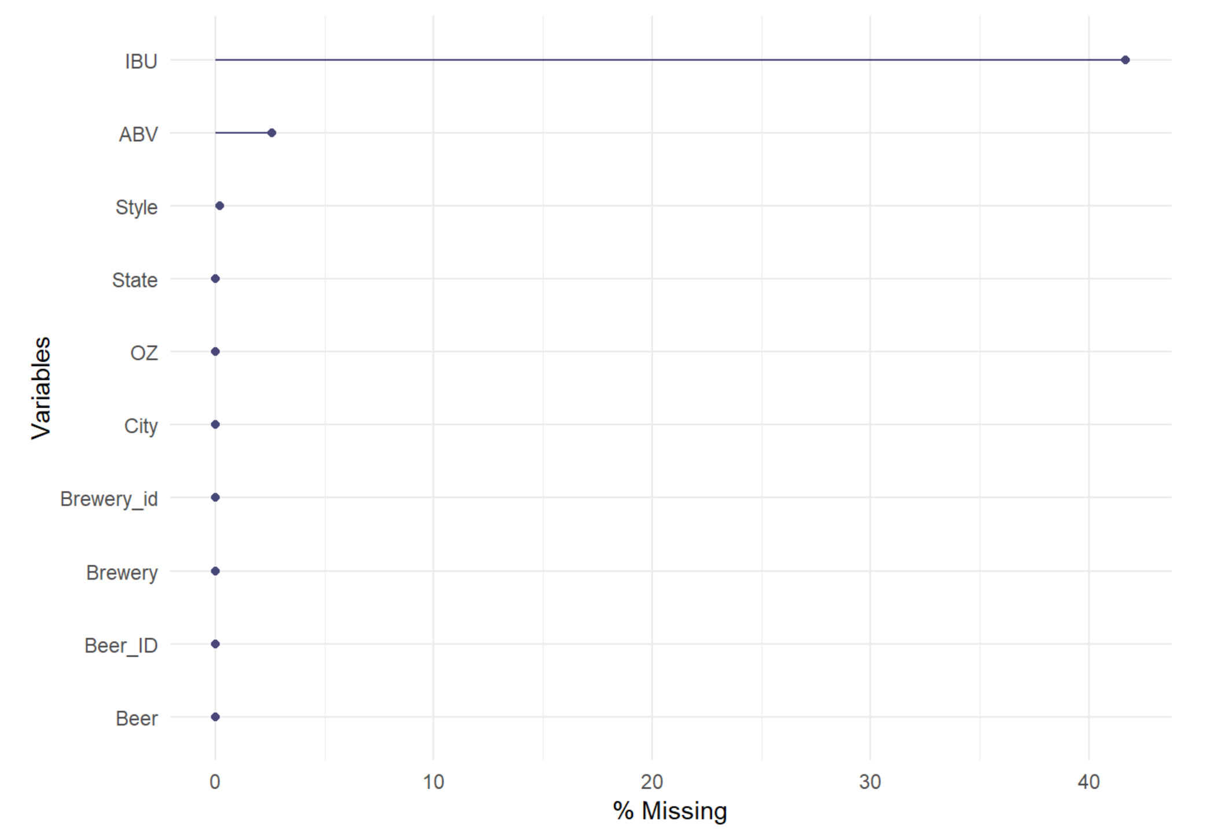
Missing Data
Parameter | Missing Values
IBU | 1005
ABV | 62
Style | 5
State | 0
OZ | 0
City | 0
Brewery_ID | 0
Brewery | 0
Beer_ID | 0
Beer | 0

Slide 6
Explanatory Data Analysis
Number of breweries in each state
AK | AL | AR | AZ | CA | CO | CT | DC | DE | FL | GA | HI
7 | 3 | 2 | 11 | 39 | 47 | 8 | 1 | 2 | 15 | 7 | 4
IA | ID | IL | IN | KS | KY | LA | MA | MD | ME | MI | MN
5 | 5 | 18 | 22 | 3 | 4 | 5 | 23 | 7 | 9 | 32 | 12
MO | MS | MT | NC | ND | NE | NH | NJ | NM | NV | NY | OH
9 | 2 | 9 | 19 | 1 | 5 | 3 | 3 | 4 | 2 | 16 | 15
OK | OR | PA | RI | SC | SD | TN | TX | UT | VA | VT | WA
6 | 29 | 25 | 5 | 4 | 1 | 3 | 28 | 4 | 16 | 10 | 23
WI | WV | WY
20 | 1 | 4

Slide 7
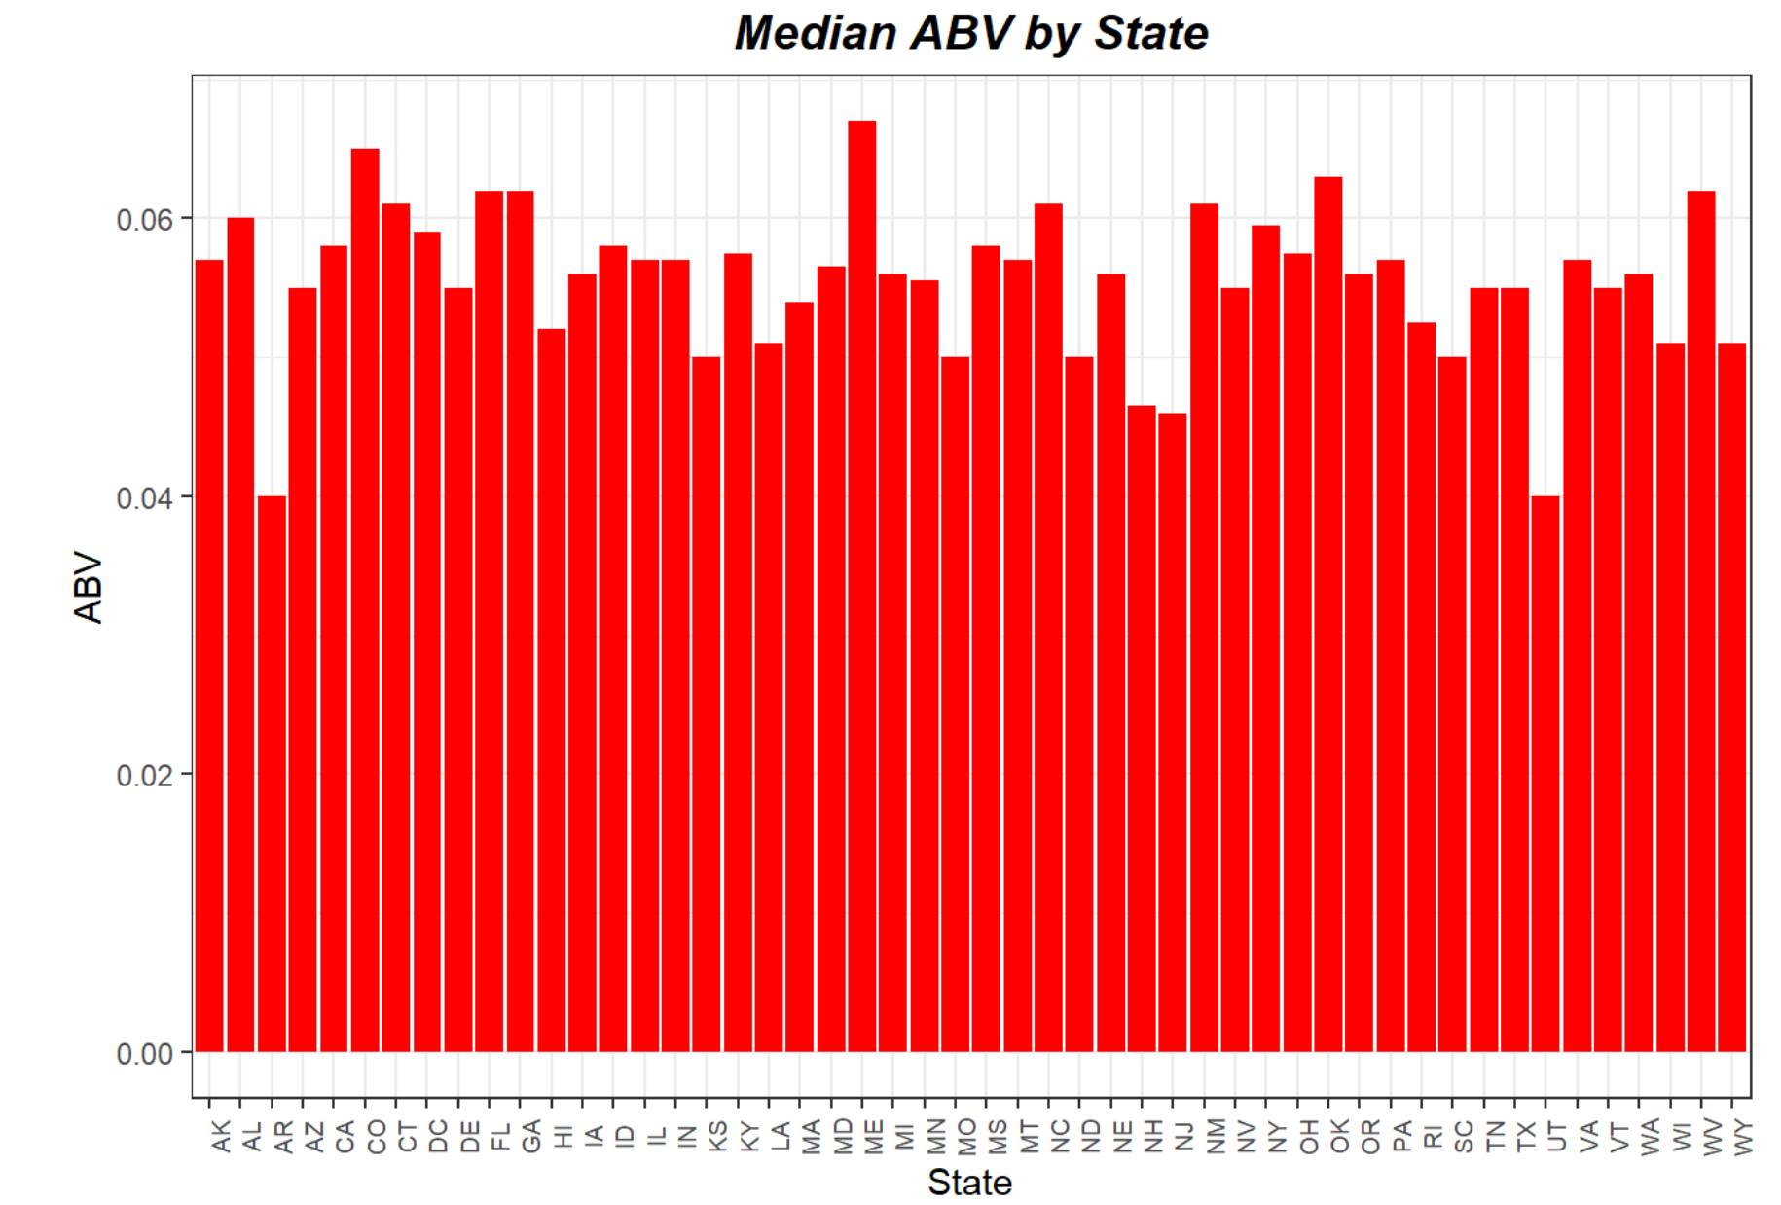
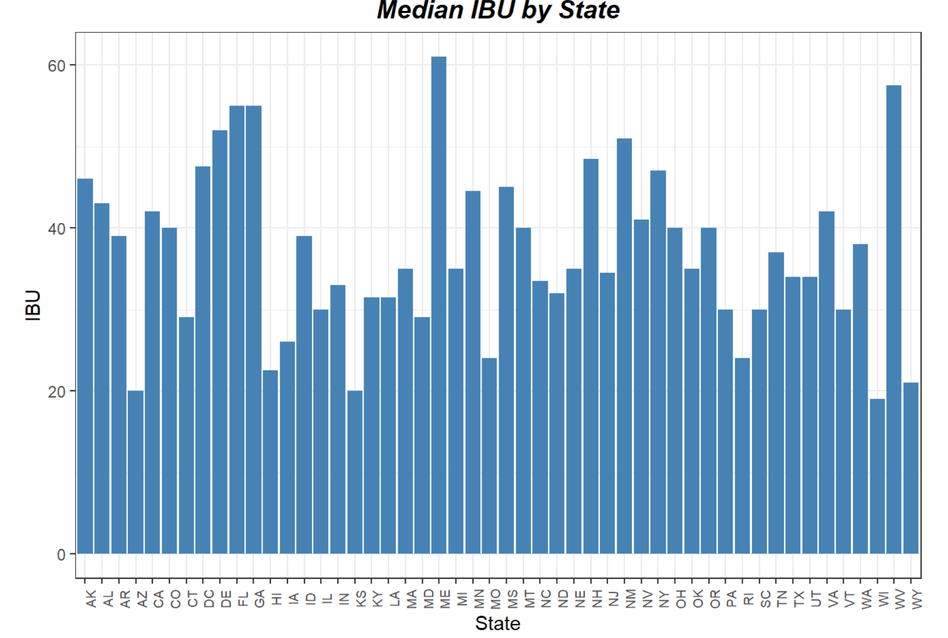
Plot of Median ABV and IBU by State

Slide 8
Maximum ABV and IBU
Which state has the maximum alcoholic (ABV) beer?
Colorado 0.128
Upslope Brewing Company
Lee Hill Series Vol. 5
Which state has the most bitter (IBU) beer?
Oregon 138
Astoria Brewing Company
Bitter Bitch Imperial IPA

Slide 9
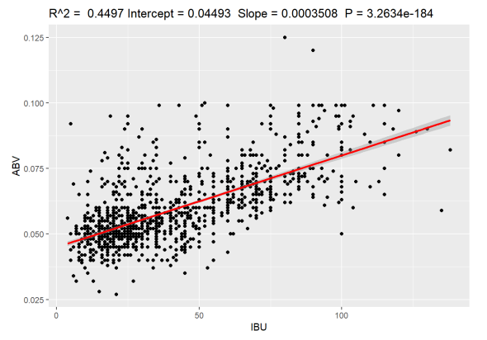
Modeling Bitterness and Alcoholic Content Relationship
ABV= 0.04493 + 0.0003508(IBU)

Slide 10
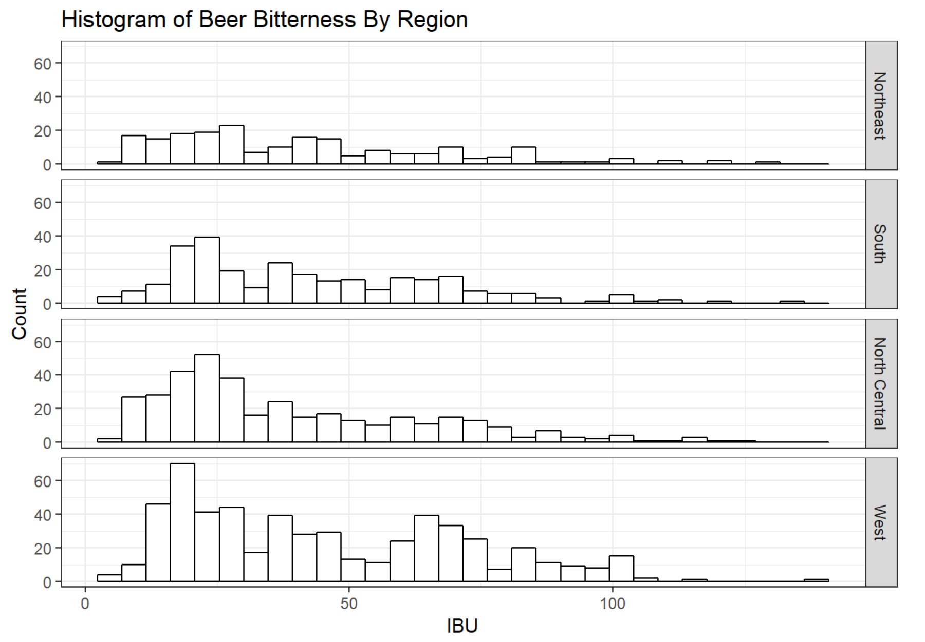
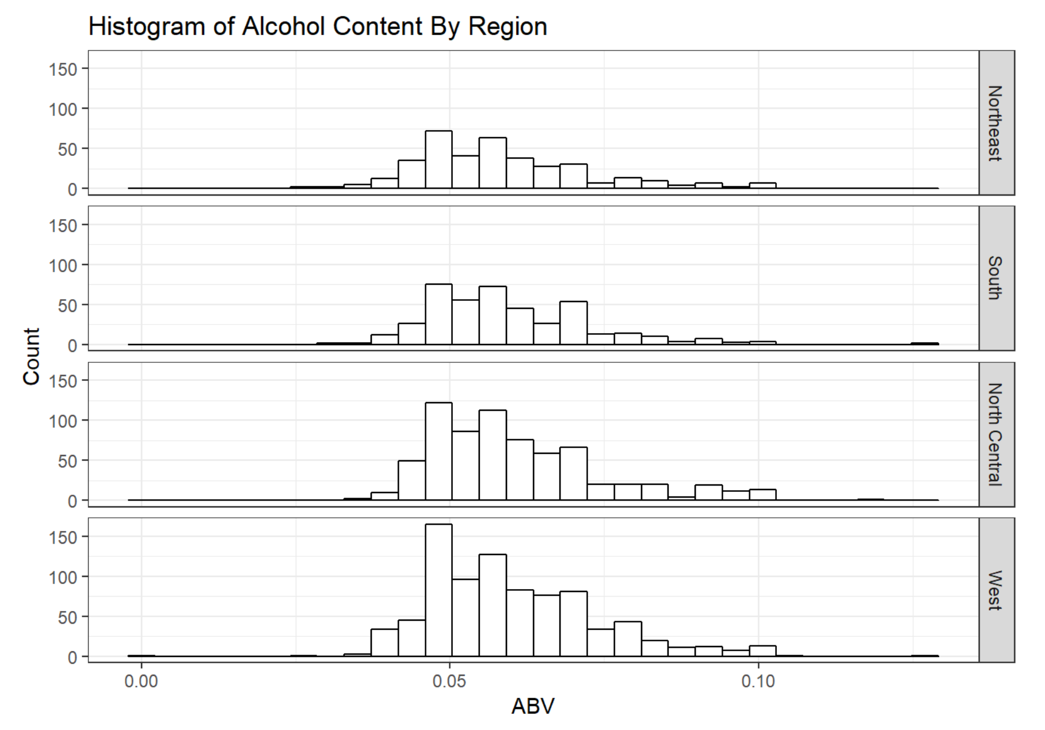
ABV and IBU Histogram per Region

Slide 11
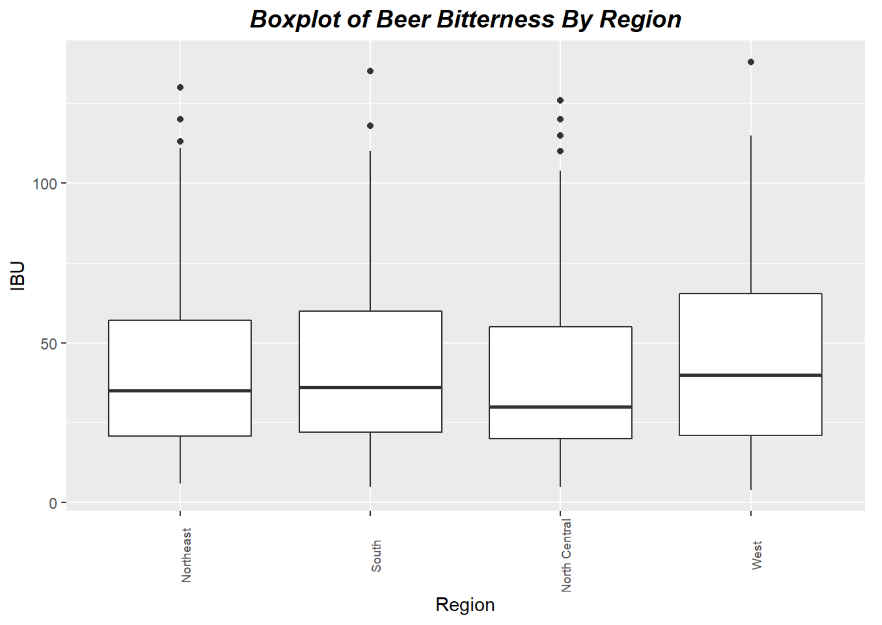
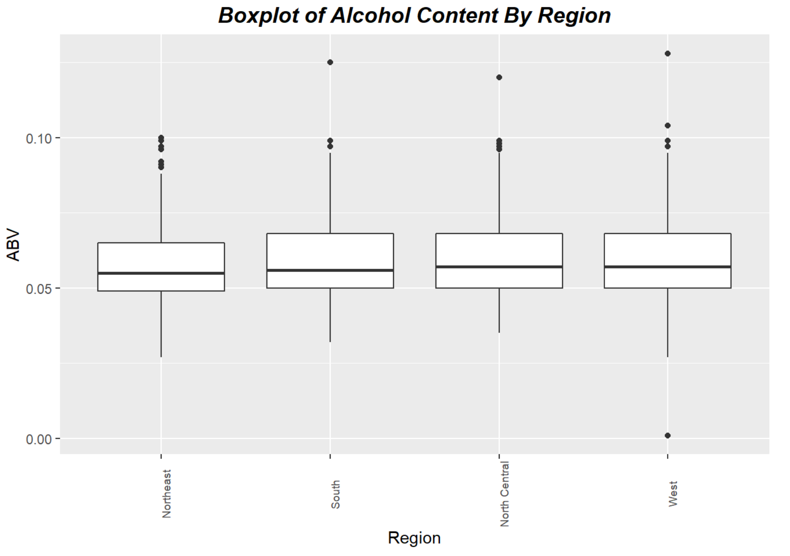
ABV and IBU Boxplot for Region

Slide 12

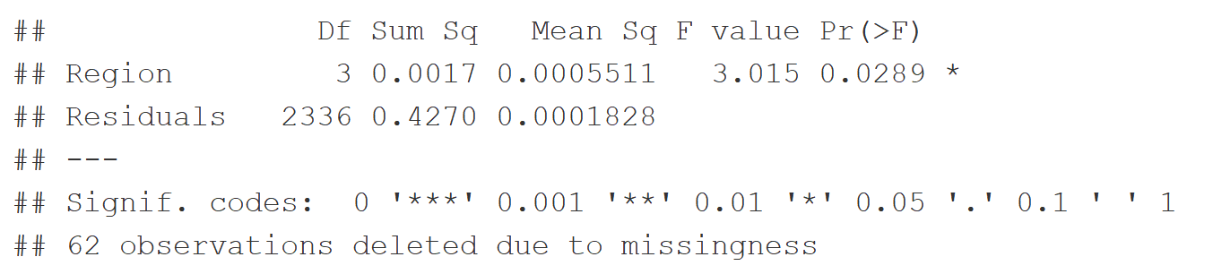
Analysis of variance for ABV
Comparing the p-value of 0.0289 to a confidence level of 0.05, we can conclude that the ABV differs in each region. Using the Bonferroni Multiple Comparison Procedure, we find specifically that the ABV differs in the North Central and Northeastern regions.

Slide 13
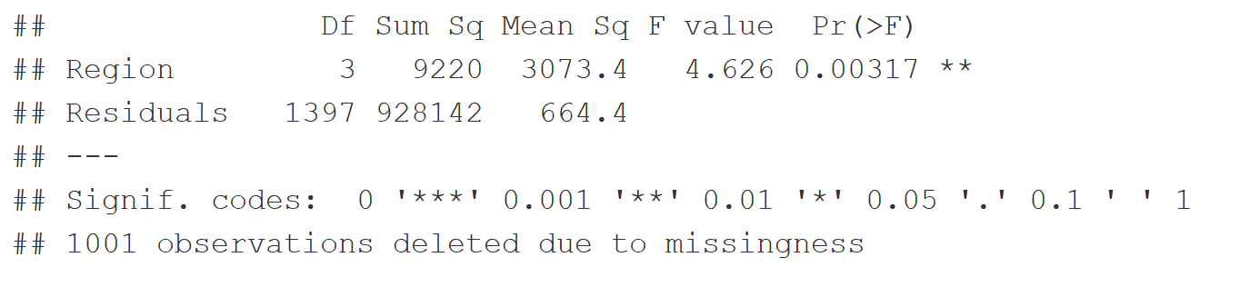
Analysis of variance for IBU
Comparing the p-value of 0.00317 to a confidence level of 0.05, we can conclude that the IBU differs in each region. Using the Bonferroni Multiple Comparison Procedure, we find specifically that the IBU differs in the West and North Central regions.

Slide 14
Conclusion
Relationship between ABV and IBU
Boost sales by catering to the preferences of those who drink Budweiser
Business opportunity

Slide 15
Question

